Slide 1
TOURISME DE LUXE AU QUEBEC, A-T-ON TOUT CE QU’il faut?

Slide 2
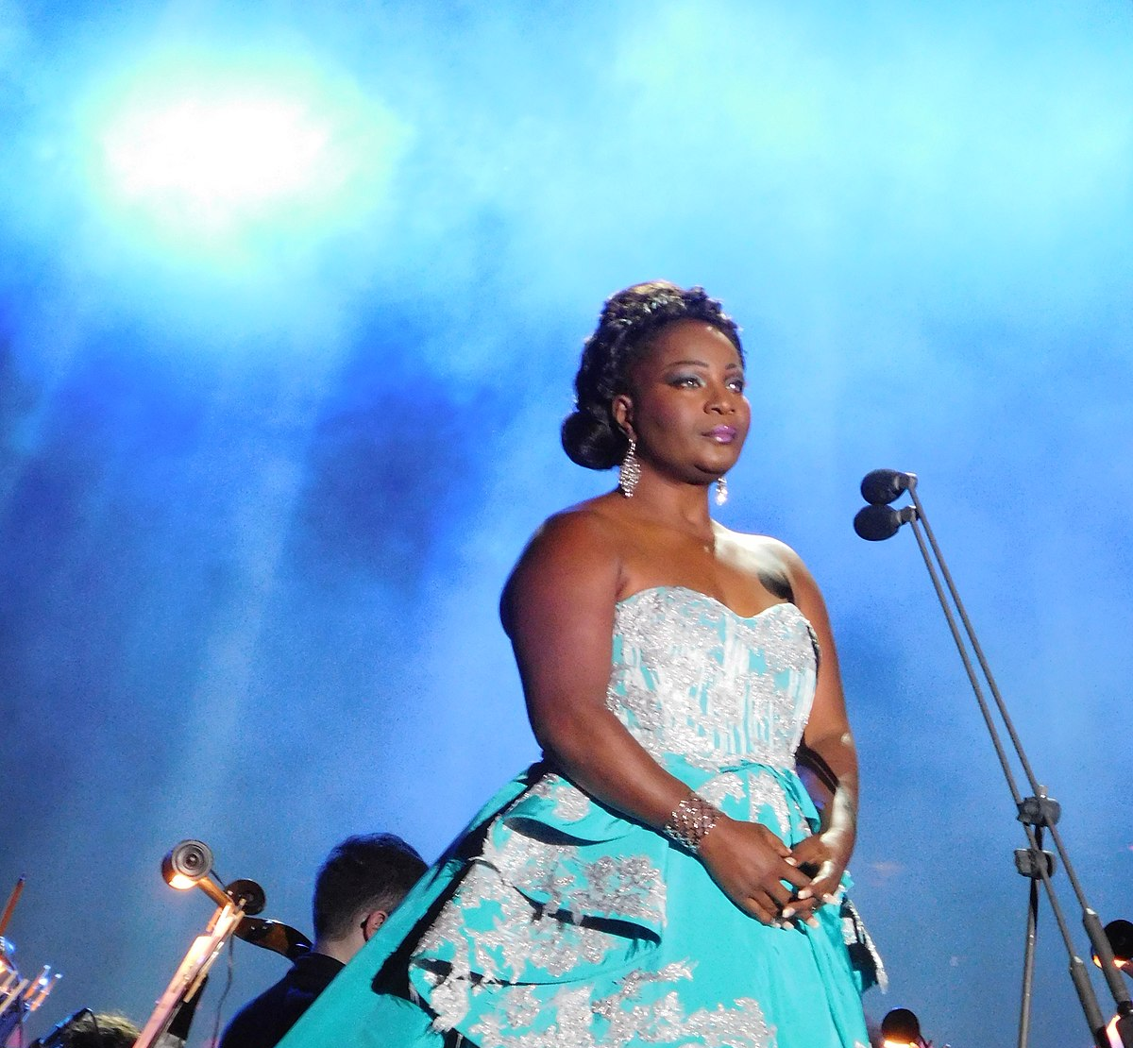
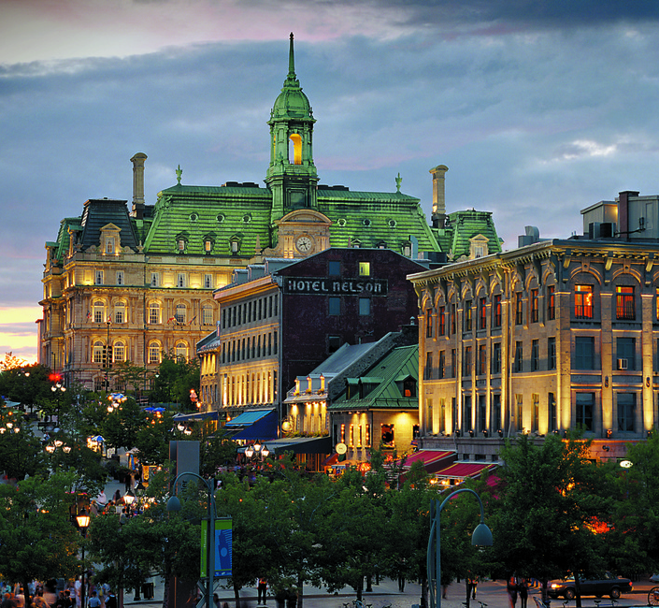
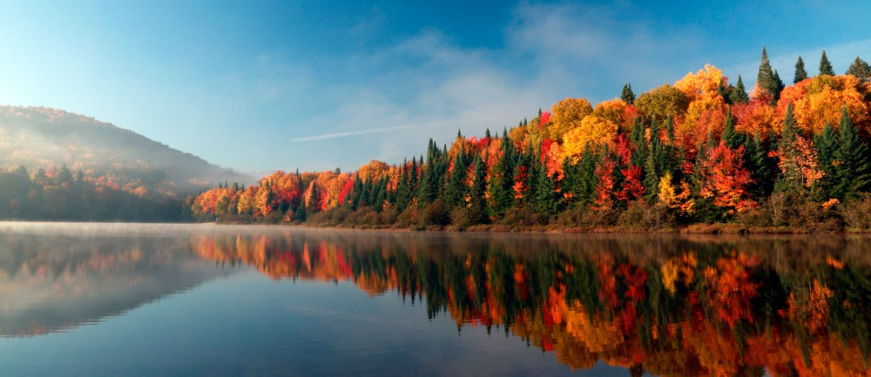
QU’EST-CE-QUI VOUS FAIT DOUTER?

Slide 3
FAISONS CONNAISSANCE!

Slide 4
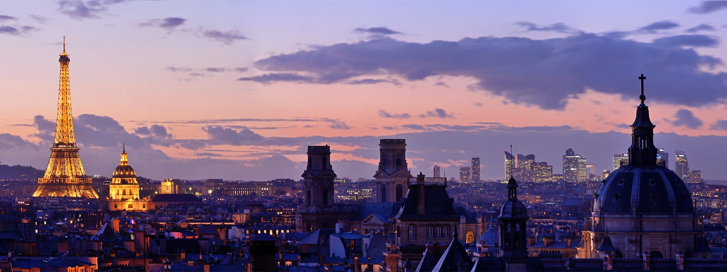
SUR LE CHEMIN DE DAMAS…PARIS!

Slide 5
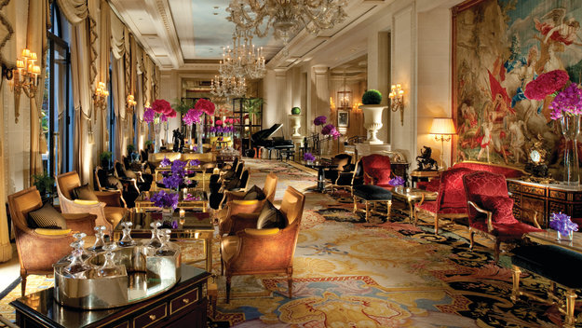
le nouveau monde vient défier L’ANCIEN

Slide 6
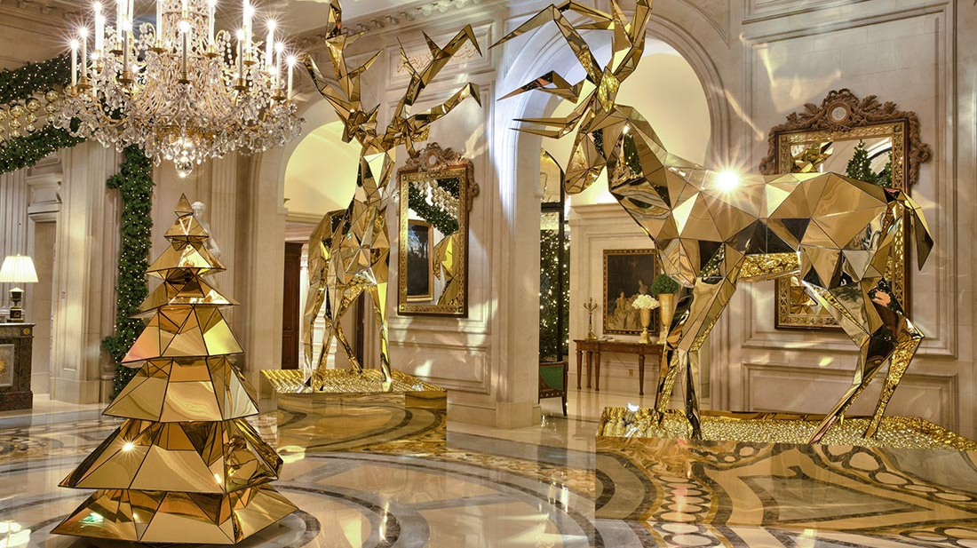
FOUR SEASONS GAGNE son “PARIS”
Notes:
It’s time to level set, what is a winning strategy?
*FN*flip chart responses so we can look back at them later in the day to show the progress of the group’s strategic thinking through out the day. Assist with flip charting responses.
Identify your business goals
To develop your marketing strategy, identify your overarching business goals, so that you can then define a set of marketing goals to support them. Your business goals might include:
increasing awareness of your products and services
selling more products from a certain supplier
reaching a new customer segment.

Slide 7
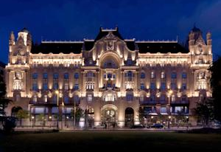
UNE vision UNE SEULE REGLE
Se comporter avec autrui très exactement comme nous comptons l’être en retour.

Slide 8
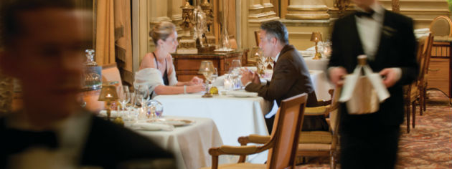
LES QUATRE PILIERS: Qualité, Service, CuLTUre, Brand
Notes:
Q:We will only operate medium-sized hotels of exceptional quality with an objective to be the best
S: True luxury will be defined not by architecture or décor, but by service. So we must make the quality of our service our distinguishing feature and a competitive advantage
C: We will create a work ethic based on the Golden Rule to give our people a framework to pursue a superior service culture
B: We will grow as a management company and build a brand name synonymous with quality

Slide 9
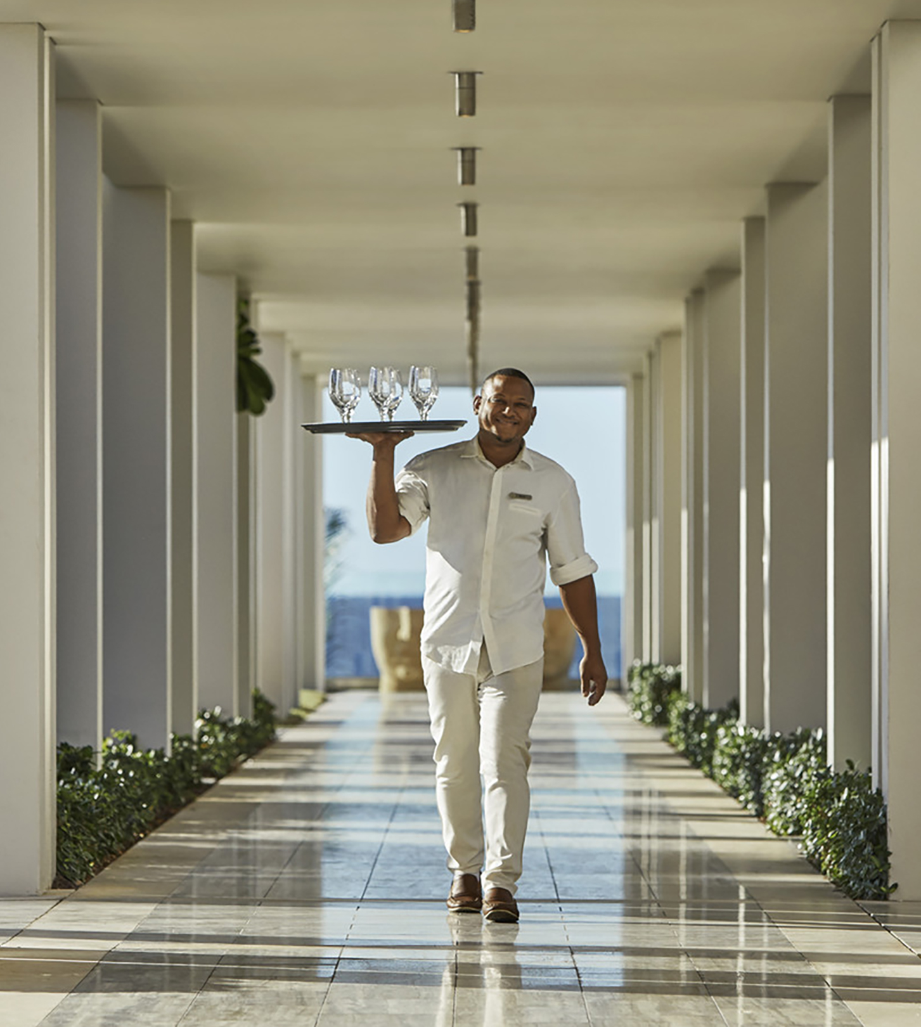
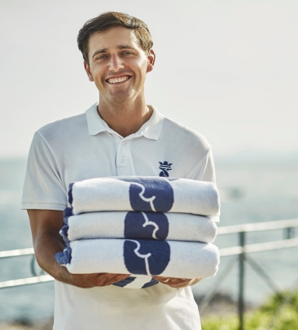
DES STANDARDS DE QUALITé INCONTOURNABLES QUI FONT SENS

Slide 10
POURQUOI SONT-ILS (AUSSI PEU) NOMBREUX A S’INSPIRER DE CE MODELE?

Slide 11
Notes:
Most companies and organizations begin to organize their plans by first developing a vision. A vision focuses on the potential inherent in their future, or what they intend to be. And while a vision statement might contain references to how a company intends to make that future into a reality, the “how” is really part of the mission.
The strategy provides us with the plan for differentiating ourselves and fulfilling the mission. The strategy is supported by a tactical action plan that details exactly how the strategy is going to be supported, implemented and measured.
As I mentioned first, a vision focuses on the inherent potential of a company and many companies combine their vision and mission statements…

Slide 12
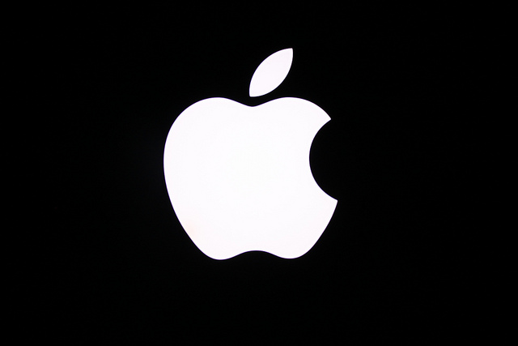
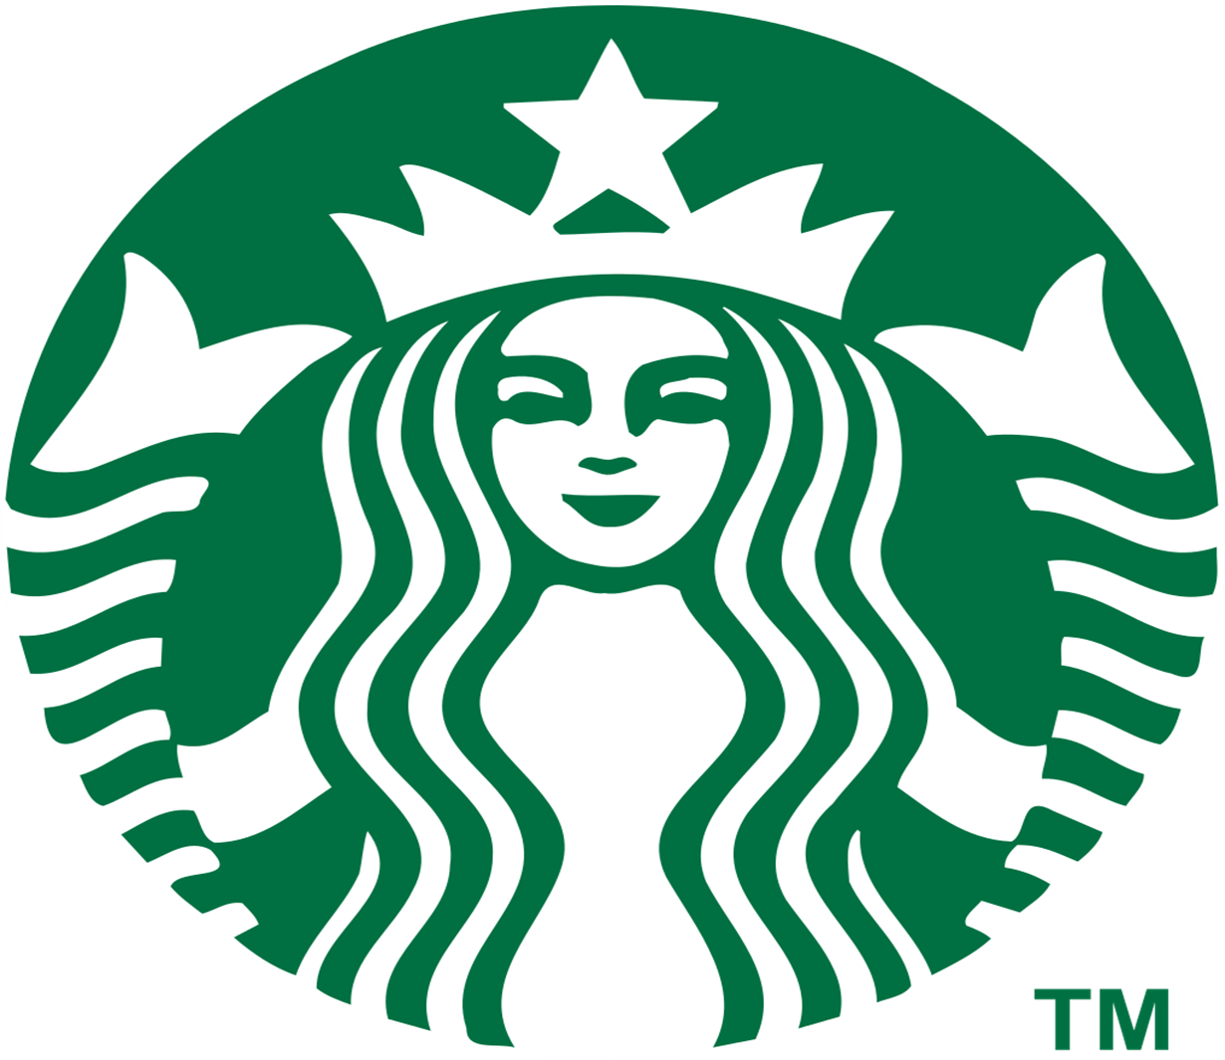
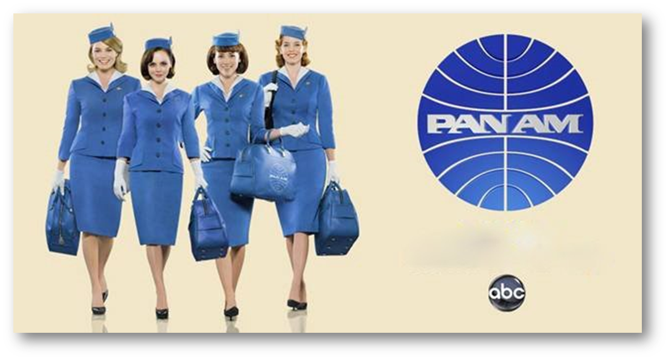
Notes:
Starbucks developed an “affordable-luxury” product and they currently deploy numerous strategies to maintain their competitive edge.
“Perfect Cup of Coffee” – Starbucks history has shown that they place a huge emphasis on product quality. Their coffee, even if priced slightly more expensive than expected, is notorious for satisfying customers with its rich, delicious taste and aroma. Unless you are from Italy ☺
“Third Place” – From the very beginning, the Starbucks marketing strategy has focused on creating the “third place” for everyone to go to between home and work. Creating this unique and relaxing “experience” and “atmosphere” for people has been very important for the company as they have realized that this is one of the strongest concepts attached to the company, to which customers have been strongly attracted. Let’s look at another company that has not been so successful strategically…

Slide 13
ABANDONNER LA CULTURE PRODUIT POUR EMBRASSER UNE CULTURE CLIENT

Slide 14
BIEN CONNAITRE SES CLIENTS

Slide 15
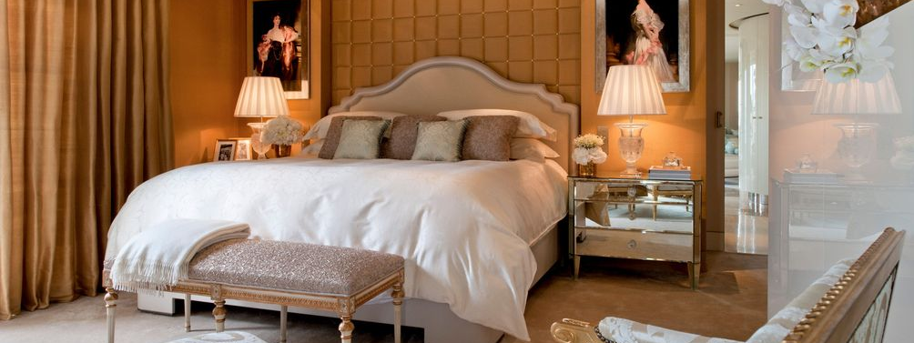
ALLER PLUS LOIN-DISTINGUER « FEATURES » et « BENEFITS »

Slide 16
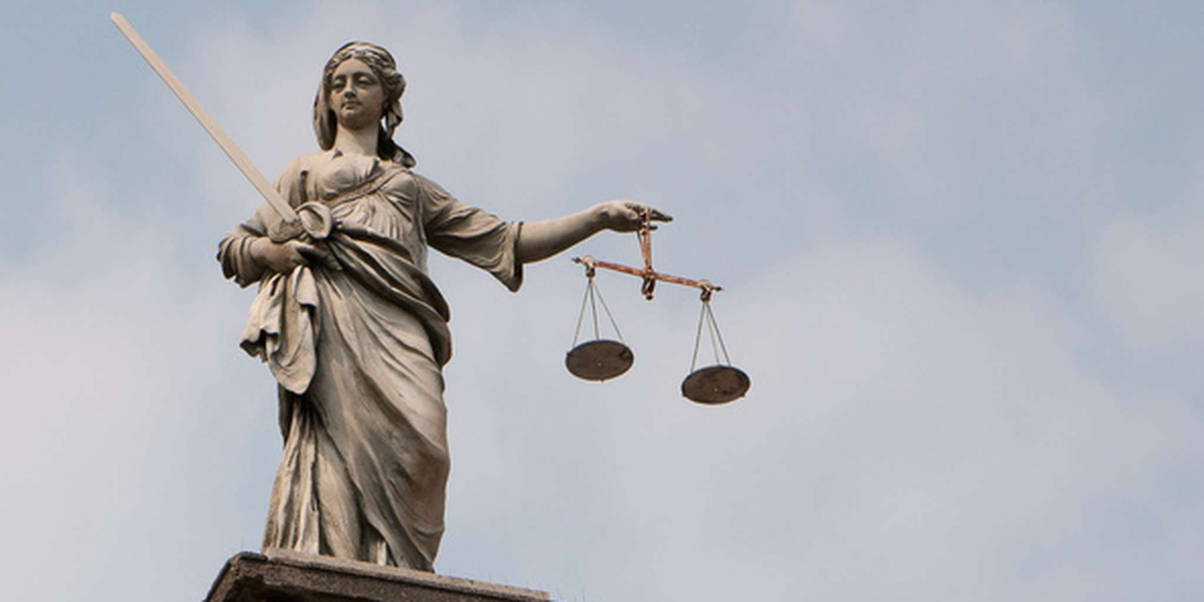
Agir en ayant ConSCIENCE de ses forces et faiblesses

Slide 17
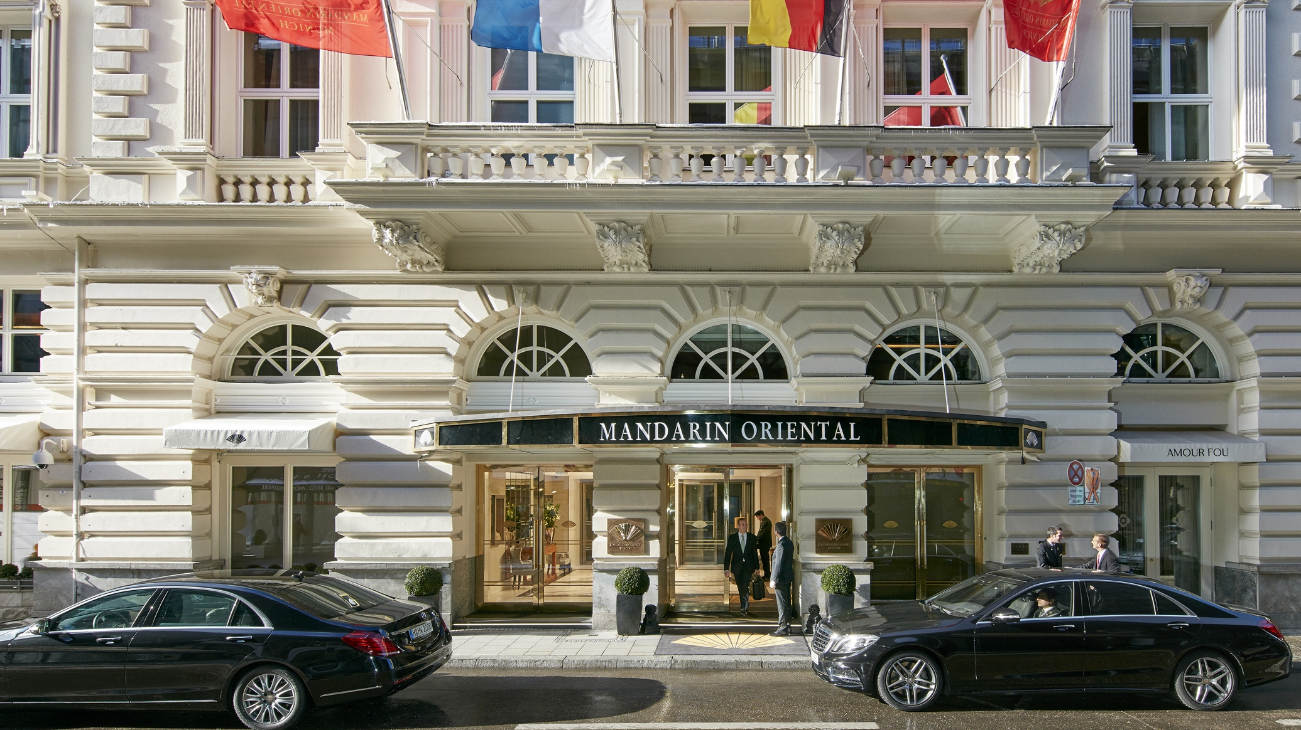
VRAI Pouvoir ET PROMESSES des marques
Notes:
When brands started to expand globally (post WW2) it was to ensure quality and consistency
Power of a brand remains debatable throughout the years, one thing is certain: Many
hotel franchising companies have adapted their business models, becoming less hoteliers and more so branding, sales and marketing experts.
“Why do a lot of people like Coca-Cola? Why do people go out of their way to by it? That’s the value of a brand
Marriott buying Starwood, Accor buying Fairmont, Raffles, and Swissotel,
To get customers to think first of their branded websites they need to book a hotel room, instead of going to an Expedia.
Four Seasons, which has only one brand and no loyalty program, for example. It is trying to differentiate itself through branded experiences and personalized levels of service.
It seem like so many brands are reinventing themselves.
Problem (e.g. Sheraton° was having was that the consistency of the properties
Great legacy brands to work with may also have different customer perceptions in Asia versus the U.S. for instance

Slide 18
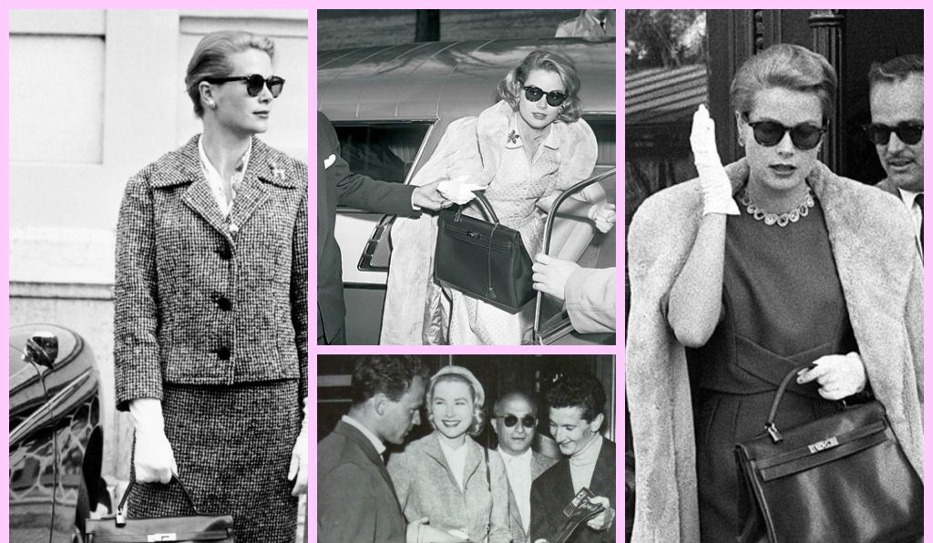
Et le logo disparut

Slide 19
LES TROIS DIMENSIONS DU SERVICE
Dimension professionnelle
Dimension humaine
Dimension esthétique

Slide 20
LA GENTILLESSE, une faiblesse? Think twice !
BIENVEILLANCE
INTEGRITE
HUMILITE
PATIENCE
GENEROSITE
DON
GRATITUDE
HUMOUR
CONVICTION
LIMITES

Slide 21
Il est vraisemblable que vos clients oublierons ce que vous leur avez dit,
mais ils n’oublieront jamais ce qu’ils ont ressenti.

Slide 22
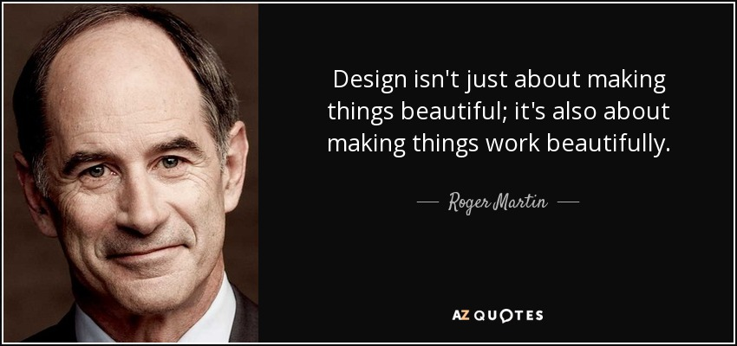

Slide 23
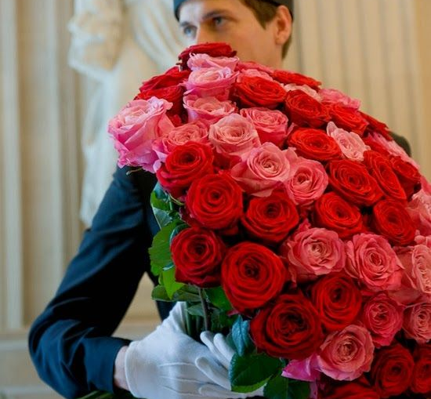
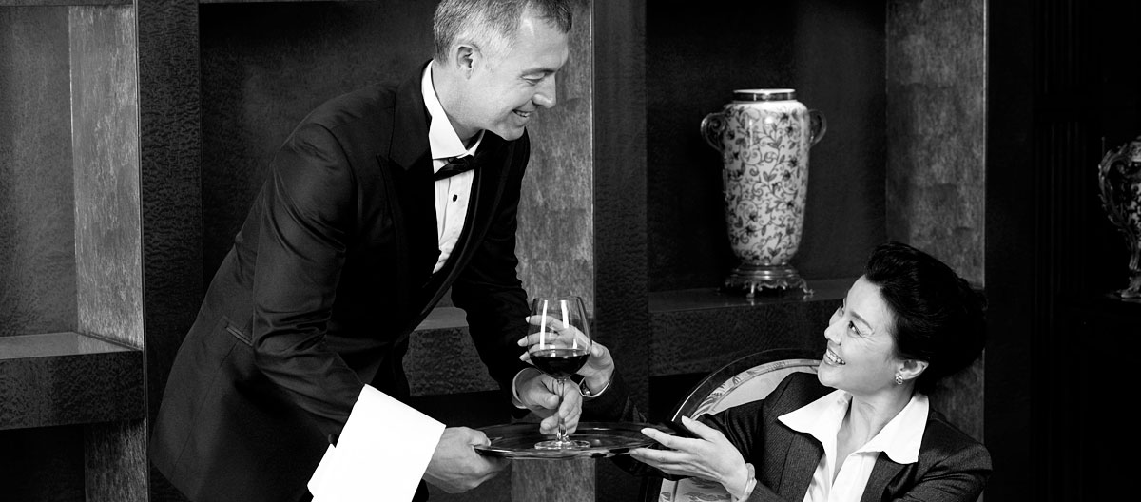
GET IT RIGHT GET ME RIGHT WOW ME IF YOU CAN

